Slide 1
Stormwater Management: TCNJ Townhouses South
Kelly Hommen
Elizabeth Lafferty
Michael Murphy
Charles Stewart
Advisors: Dr. Michael Horst and Dr. Vedrana Krstic
1

Slide 2
Introduction
26 individual units
20 have noticeable moisture
15 have standing water
Main concerns
Termite damage
Mold
Is this a runoff or an infiltration problem?
2

Slide 3
Site Location
3

Slide 4
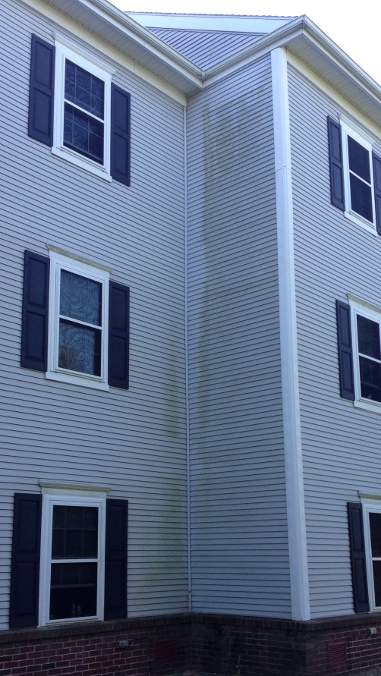
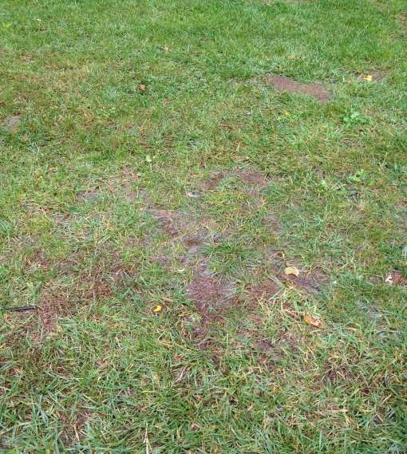
Photos
4

Slide 5
Problem Statement
How can the presence of moisture be significantly reduced from the crawlspaces to minimize the likelihood of termites and mold?
5

Slide 6
Solution
Conduct hydrologic and soil analysis on the area in question to determine the properties of the watershed
Apply the data to determine total losses for given design storms
Computer Modeling (HEC-HMS)
Develop a cost effective solution to remediate the problem previously stated
6

Slide 7
Soil Analysis
Performed By:
Kelly Hommen & Elizabeth Lafferty
7

Slide 8
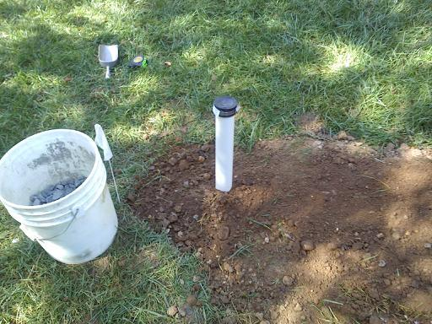
Soil Analysis
Augured two test holes
Collected soil samples 8.5 ft in depth
Conducted percolation tests in two locations
Installed a well for groundwater
table monitoring
8

Slide 9
Test Locations
Monitoring Well / Boring Sample 2
Percolation Test 1
Percolation Test 2
Boring Sample 1
9

Slide 10
Soil Tests
Moisture Content (ASTM D-2216)
Sieve Analysis (ASTM D-422)
Grain Size Distribution Curves
Atterberg Limits (ASTM D-4318)
Liquid Limit
Plastic Limit
Percolation Testing (NJBMP Manual)
Permeability
Burmister Soil Identification Method
10

Slide 11
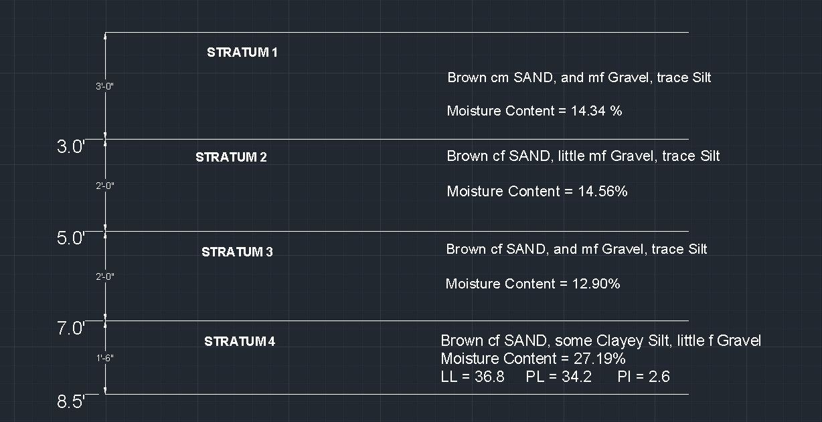
Soil Profile
11

Slide 12
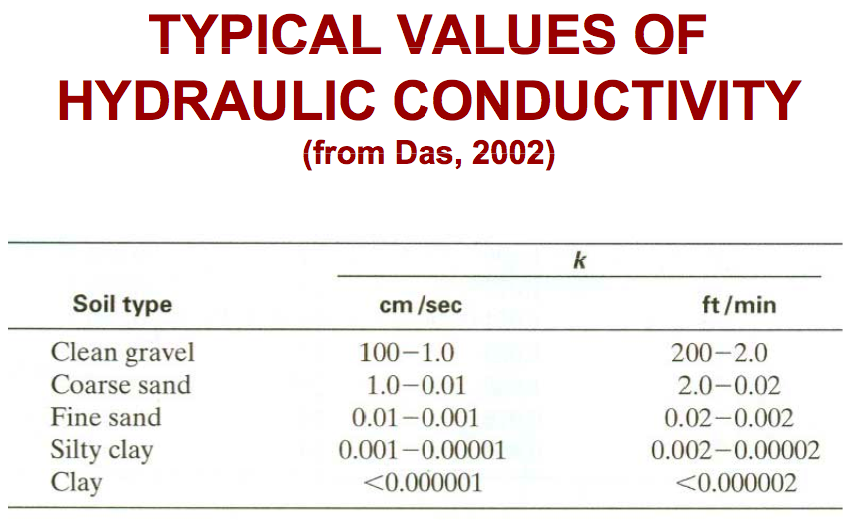
Permeability
Percolation Test conducted in two locations
Represents the top 5 feet of soil profile
Permeability ≈ 0.001323
ft/min
Consistent with Das values for Fine Sand
with Silt
12
Notes:
Compare to soil profile findings of silty sand

Slide 13
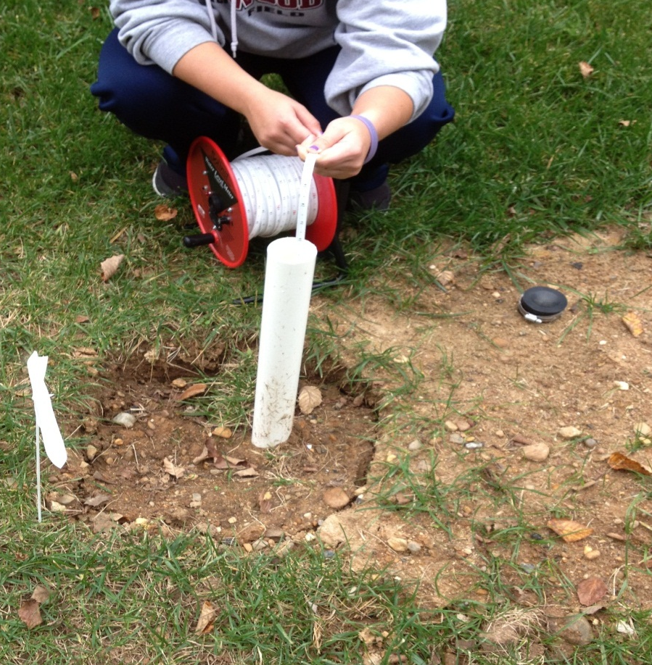
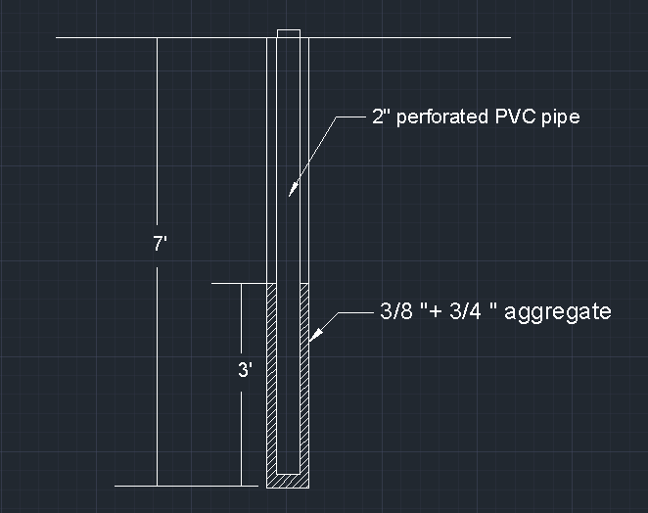
Ground Water Well
Ground water monitoring indicated level was below 7’
13
Notes:
GWT monitoring revealed no presence of water…GWT greater than 7 ft

Slide 14
Soil Analysis Conclusion
Soil profile created
Properties confirmed through soil testing
Hydraulic conductivity consistent with fine Sand, trace Silt
i-MAP NJ (DEP) – Confirmed area of interest not a wetland
Low groundwater table provides for the potential use of detention and retention basins
14
Notes:
No significant design challenges involving soil/soil properties…infiltration problems with silty sand

Slide 15
Hydrologic Analysis
Performed By:
Michael Murphy & Charles Stewart
15

Slide 16
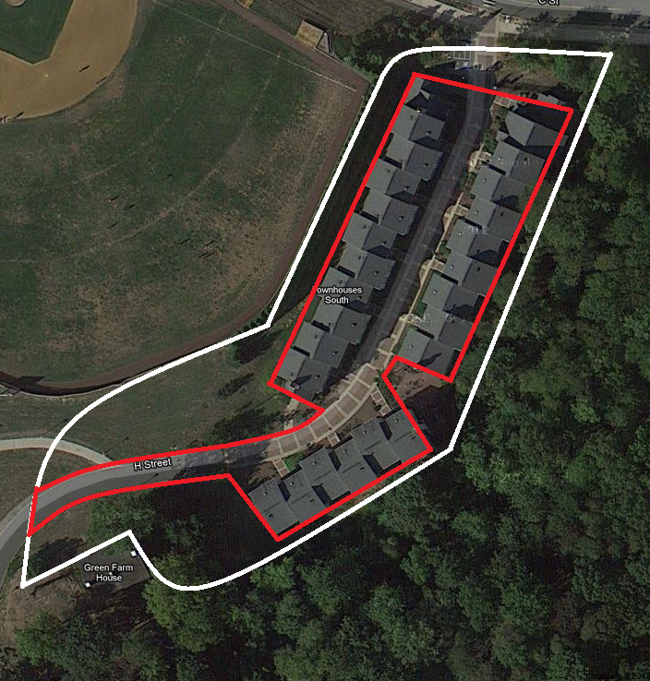
Watershed Delineation
Watershed Area: 83,736 sq. ft. = 1.92 acres
Impervious Area: 42,723 sq. ft. = 0.98 acres
Pervious Area: 41,013 sq. ft. = 0.94 acres
16

Slide 17
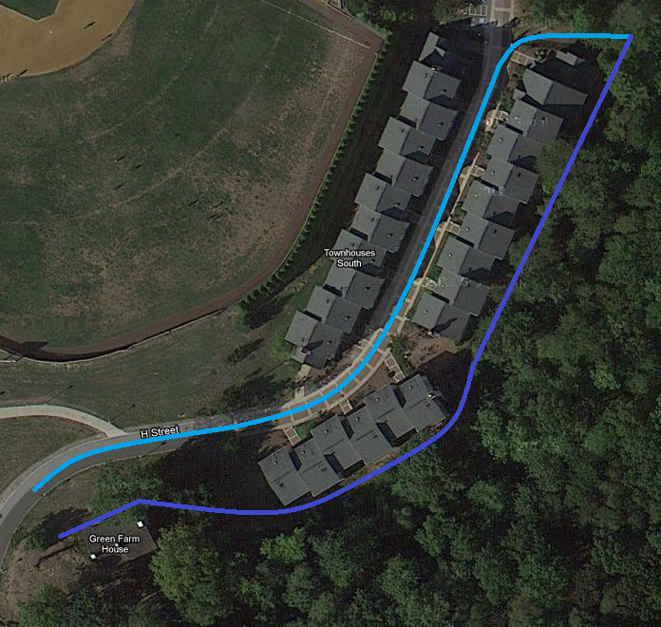
Watershed Delineation
Longest hydraulic length
Impervious: 645 ft
Pervious: 735 ft
Slope: S=Δel/LHL
Impervious S=3.89%
Pervious S=3.41%
17

Slide 18
Curve Number
Impervious
CN = 98 (for impervious areas, paved parking lots etc.)
Table 7.10 Runoff Curve Numbers for Urban Areas
Introduction to Hydrology, 5th Edition
Pervious
CN = 69 (for open lawn, fair condition, soil group B)
USGS WebSoil Survey
MbpB: Metapeake Loam
Soil group B
18

Slide 19
SCS Regression Method
SCS Regression Method used to determine lag times for later use in HEC-HMS
T_{lag} = (LHL^{0.8}*(S+1)^{0.7})/(1900*Savg^{0.5})
S=1000/CN – 10
T_{lag} pervious = 0.184 hours = 11.06 minutes
T_{lag} impervious = 0.054 hours = 3.22 minutes
19

Slide 20
Computer Modeling
HEC-HMS
20

Slide 21
Setup
HEC-HMS was used to determine the peak outflow and total losses affecting the area.
Sub-basins were created for each watershed
Sub-basin 1 – Impervious
Sub-basin 2- Pervious
Junction was created to connect the two sub-basins
Volume of total losses represents water infiltration that can contribute to flooding in crawlspaces
21
Notes:
Inputs included CN, area, and lag times for each subbasin

Slide 22
Input
Precipitation Depths were entered for a 2-yr Design Storm for 1, 2, 3, 6, 12, and 24 hours (NOAA’s National Weather Service)
Intensity: 1 hour
Duration: 1 day
22

Slide 23
Impervious Results
23

Slide 24
Pervious Results
24

Slide 25
Junction Results
25

Slide 26
Final Results
Total Losses: 2.59 inches
Impervious: 0.12 inches
Pervious: 2.47 inches
Total Infiltration
83,736 ft² * 2.59 in * (1 ft / 12 in) = 18,073 ft³
Future designs will be based on infiltration values.
26

Slide 27
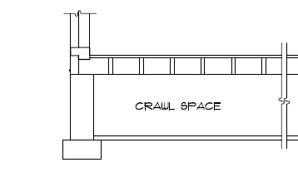
Proposed Solution #1
Re-grading of the Soil
Soil in certain areas lies above the sill plate
Allows water to enter through the porous material into the crawl space
Sill Plate
27

Slide 28
Proposed Solution #2
Design and Install Sump Pumps
The units are divided by concrete block foundation walls
Flooding is contained within each unit
When the units were constructed, pre-formed pits were installed in each of the crawl space floors
Design a pump to remove standing water
28

Slide 29
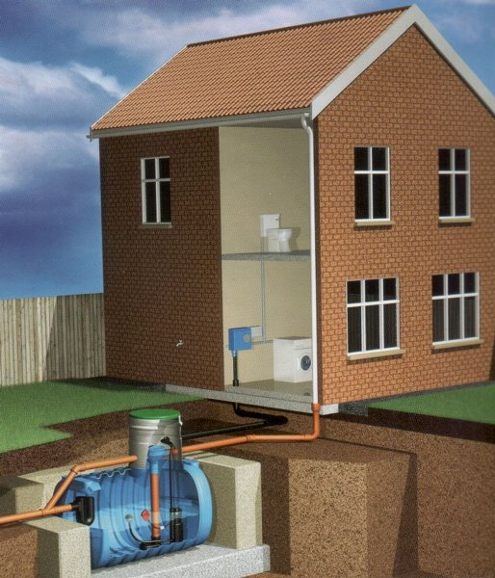
Proposed Solution #3
Roof Water Collection System
Design basin to collect roof water
Reused within the Townhouses
Discharged away from the area
29

Slide 30
Budget
Estimated Cost for Fall Semester - $240.00
Groundwater Measurement Device - $220.00
Topographic Maps - $10.00
PVC Pipe - $10.00
Full Cost Estimate to be provided in Senior Project II
30

Slide 31
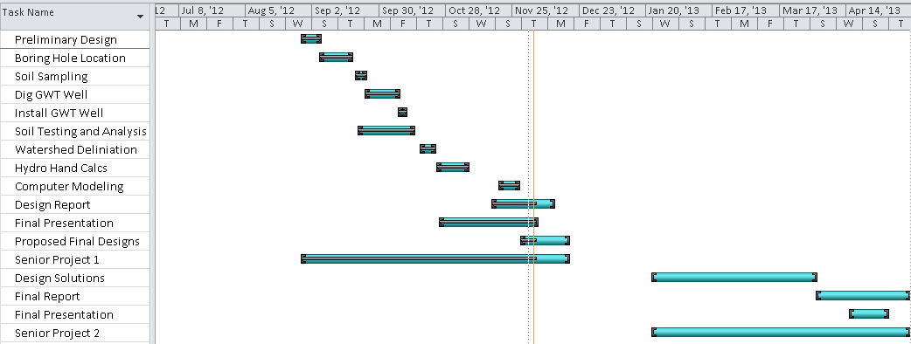
Gantt Chart
31

Slide 32
Conclusion
Soil and hydrologic analyses indicate infiltration as the main cause of the accumulation of water in the crawlspaces
Senior Project II will consist of designing solutions to alleviate this problem
32

Slide 33
Questions / Comments?
33

